Slide 1
GRANT
CERTIFICATION
TRAINING
District 6200
April 19, 2024
Notes:
(Session starts Friday at 4:00 p.m., ends at 5:00 p.m.)
(Survey attendees for interest: District v Global; specific plans)

Slide 2
LEARNING OBJECTIVES
Understand District Grants
Qualify your club to receive grant funds
Learn how to apply for a grant
Differences for Global Grants
How to find additional resources and get help
Notes:
Understand District Grants
Qualify your club to receive grant funds
Learn how to apply for a grant
Differences for Global Grants
Where to get help

Slide 3


ROTARY FOUNDATION FUNDING -
FOUR DIFFERENT FUNDS
Annual Fund
World Fund
Polio Fund
Disaster Response Fund
Notes:
Annual Fund – “checking account”
World Fund – “savings account”
Polio Fund – spent almost immediately, Gates Foundation match
Disaster Response Fund – club & district grants, can’t specify the disaster

Slide 4
ROTARY FOUNDATION FUNDING
SHARE SYSTEM
Donations to the Annual and Permanent Funds
Annual Fund donations invested for 3 years, then
  47.5% returned to District as District Designated Funds (DDF)
  47.5 % deposited into World Fund for match
Permanent Fund donations aren’t spent, but interest is added to our DDF
Notes:
Donations to annual & permanent funds can return to our District and your clubs
Donations to Annual Fund are held for 3 years to cover administrative overhead
About half of Annual Fund donations and the interest on Permanent Fund donations become DDF
District Designated Funds
Funds your District Grants
Funds your Global Grants

Slide 5
ROTARY FOUNDATION FUNDING
SHARE SYSTEM
District Designated
Funds
Contributions
50%
SHARE
System
Our
Contributions
Earnings
50%
World Fund
Notes:
Donations are made to one of four funds
Annual & Permanent Fund donations go into SHARE system
Come out into DDF and World Fund

Slide 6
DISTRICT GRANTS
Notes:
District Grants

Slide 7

DISTRICT GRANTS FROM THE ROTARY FOUNDATION
Come from our District Designated Funds
1 District Grant/year/district
Can use ≤50% of DDF
Includes contingencies & administration
District
Grants
Notes:
Funded in relation to our contributions
1 grant/year/district
TRF won’t release district’s 1 annual grant until prior year’s grant is closed
Funds will be deposited to District’s bank or district foundation account
Can spend up to 50% of District Designated Funds on District Grants
Can budget for contingencies & grant-related administrative expenses

Slide 8
DISTRICT 6200’S 2024-2025 DISTRICT GRANT
What we will receive:
  2021-2022 donations from D6200: $240,802
  2024-2025 DDF: $114,381
  2024-25 D6200 District Grant: $57,190
How it will be spent:
  20% for contingencies: $11,438
  3% for grant administrative expenses: $1,716
  2024-2025 Club Grants: $44,036 available
Notes:
Can spend up to 50% of District Designated Funds on District Grants
2021-2022 donations: $240,801.61
2024-2025 District Designated Funds: $114,381 (47.5%, 47.5% to World Fund)
2024-25 D6200 District Grant: $57,190 (50% of D6200’s DDF)
Can budget up to
20% for contingencies ($11,438)
3% for grant-related administrative expenses ($1,716)
2024-2025 Club Grants: $44,036

Slide 9
DISTRICT GRANTS REQUIRE
Active Rotarian participation in the project
District and clubs are current on their dues & reports
Compliance with branding
Approval for any changes
Project completion w/in 24 months of funding
Final report to TRF w/in 12 months of payment or 2 months of last expense
Use of funds must be reported to clubs
Notes:
Require:
Active Rotarian participation in the project\
Current on dues & reports
Compliance with branding
Approval required for all changes
Project completion w/in 24 months of receipt of funds
Final reports w/in 12 months of payment or 2 months of last expense
Use of District Grant funds must be reported to member clubs

Slide 10
DISTRICT GRANTS CAN FUND
Youth Programs
  Rotary Youth Exchange
  Rotary Youth Leadership Awards (RYLA)
  Rotaract and Interact
Friendship Exchange
Vocational Training Teams
Scholarships paid to the school, not the student
Community need assessments
Construction & Renovation projects
Projects where there are no Rotary clubs
Notes:
Can Fund:
Youth Programs
Rotary Youth Exchange
Rotary Youth Leadership Awards
Rotaract
Interact
Friendship Exchange
Vocational Training Teams
Scholarships
Community need assessments
Construction & Renovation
Projects where there are no Rotary clubs

Slide 11
DISTRICT GRANTS WON’T COVER
Expenses incurred prior to TRF approving the grant
Expenses ≥$75 without receipts
Activities primarily carried out by another organization or administrative overhead of another organization or simply “handing a check” to another organization
Fundraising
Public Relations (unless part of your project)
Unrestricted cash to a beneficiary/other organization
Travel to National Immunization Day
International travel for someone <18 years old
Notes:
Won’t Cover:
No eligible expenditures before to TRF approves the grant
Receipts required for expenses ≥$75
Activities primarily carried out by another organization
Administrative overhead of another organization
Fundraising
PR (unless part of project)
Unrestricted cash to a beneficiary or another organization
Travel to National Immunization Day
International travel for someone <18 years old

Slide 12
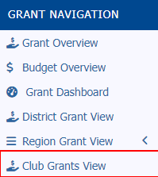

DISTRICT 6200 GRANT PROCESS
Two qualified club members
Enter goals in Rotary Club Central
Notify District & R.I. of Foundation Chair
Complete application in DACdb
  Detailed description
  Budget
  Club contacts
  Attach supporting documents
Notes:
Process
Get 2 members qualified: online at District or RI websites
Enter club’s TRF giving goals in Rotary Club Central
Notify D6200 & R.I. of club TRF Chair
Use your DACdb account to complete the 4 page, online application
Detailed description
Budget
Club contacts
Supporting documents (MOU, Partner MOU, etc.)

Slide 13
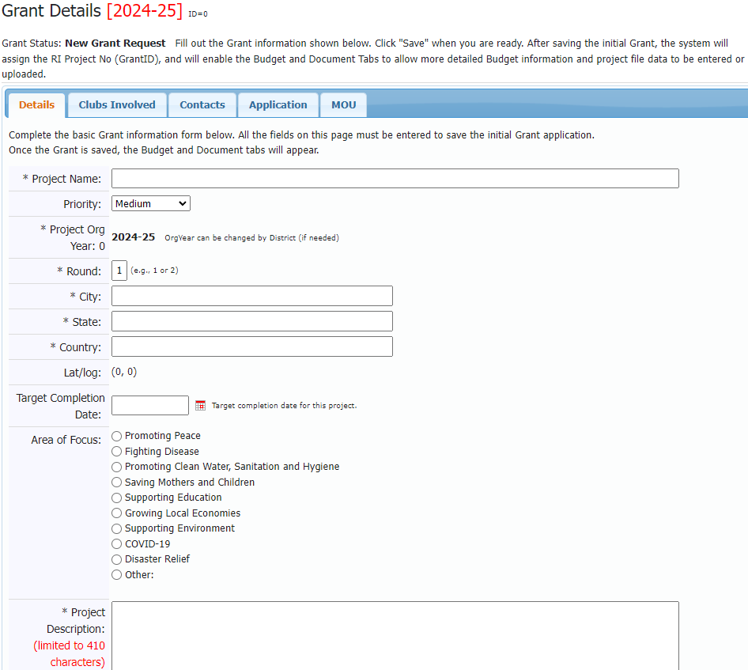
GRANT APPLICATION - DETAILS
Notes:
Description:
Must be a Rotary project, not another organization’s project you are funding
Can partner with up to 3 other club(s)
Smaller activities and projects (≤$2,000)
Local or international activities
Consistent with Rotary’s mission

Slide 14
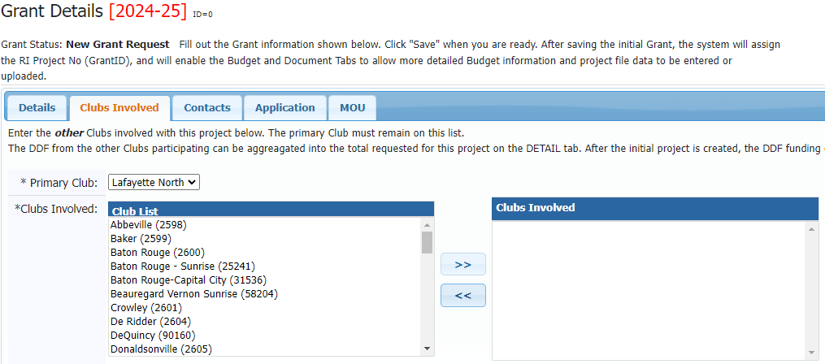
GRANT APPLICATION – CLUB(S)
Notes:
Select the club(s) involved from the left
Add them to the right

Slide 15
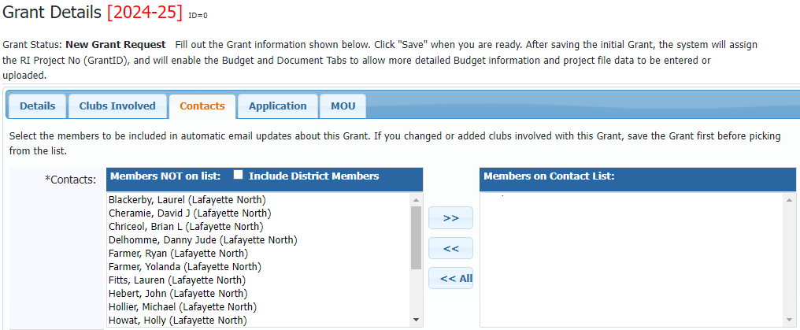
GRANT APPLICATION – CONTACTS
Notes:
Select the club’s contact person(s) involved from the left
Add them to the right

Slide 16
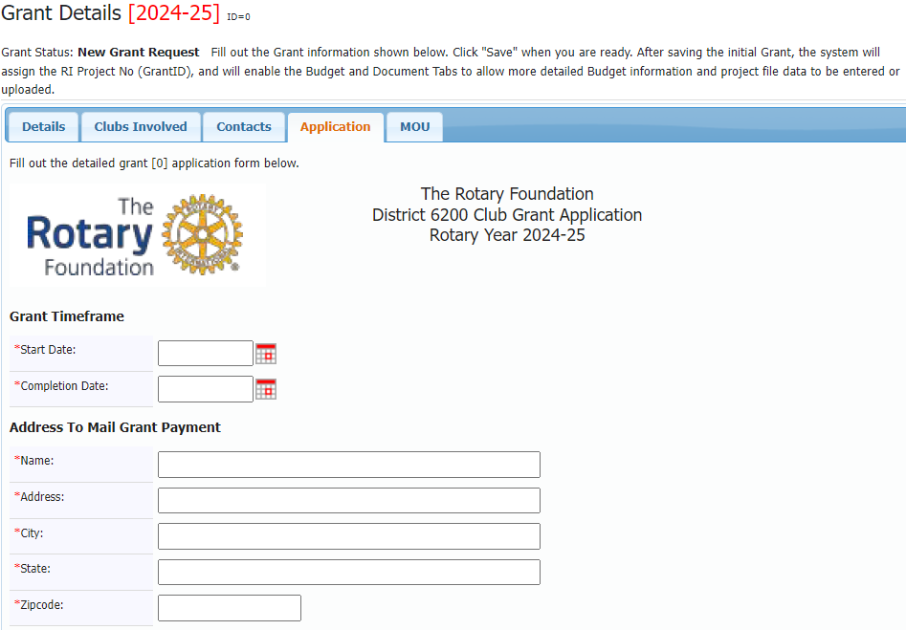
GRANT APPLICATION – TIMEFRAME, PAYMENT
Notes:
When will the project start and end?
Where should the check be sent?

Slide 17
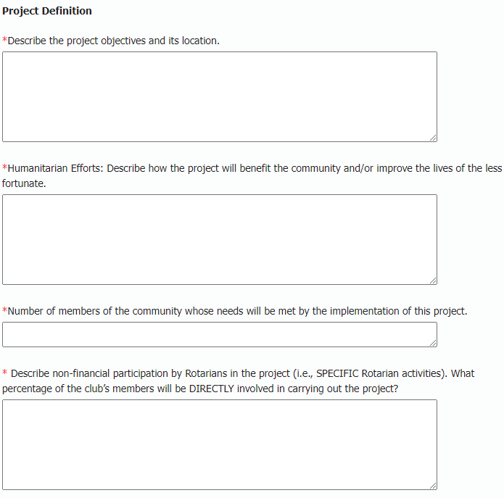
GRANT APPLICATION – DETAILS
Notes:
What are you trying to accomplish?
Where will the project happen?
How will the community benefit?
How many people will be helped?

Slide 18
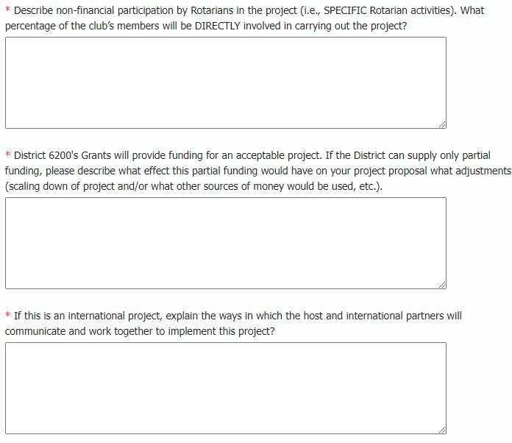
GRANT APPLICATION – DETAILS
Notes:
What will your club members be doing besides writing a check?
How many of them will be directly involved in the project?
If the District can’t fully fund the project, how can you adjust? (Is it downwardly scalable?)
What’s the communication plan if it is an International project?

Slide 19
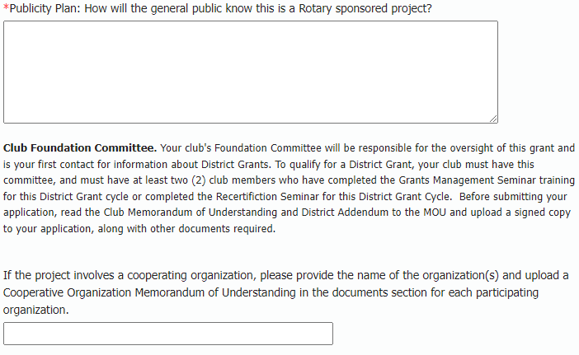
GRANT APPLICATION – PUBLICITY, ATTACHMENTS, PARTNERS
Notes:
How will you let people know this is a Rotary project? (Publicity)
Upload Club Memorandum
If you are cooperating with another organization (school, community center, city, etc.) attach its MOU
Attach checklist

Slide 20
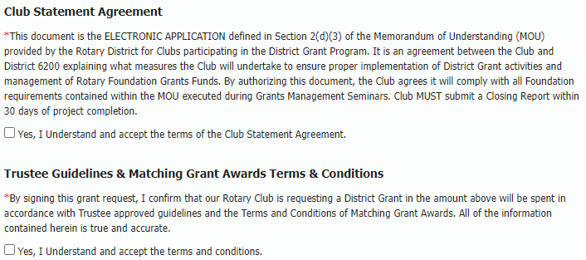
GRANT APPLICATION – AGREEMENTS
Notes:
Certify that you understand the terms & conditions of the grant

Slide 21
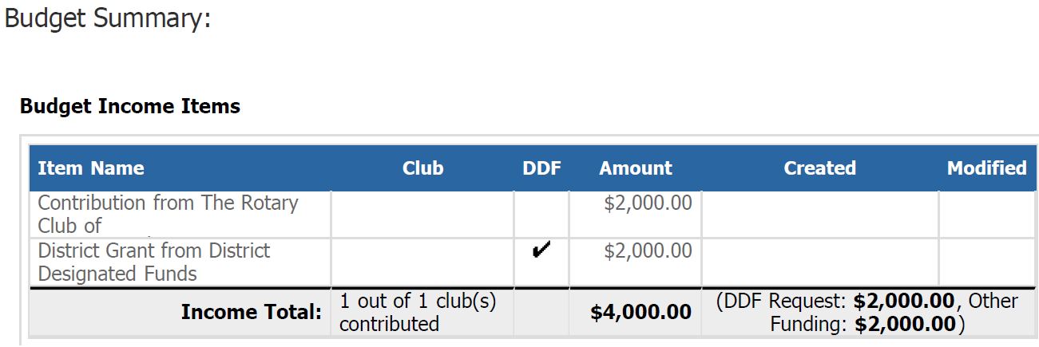
GRANT APPLICATION - BUDGET
Notes:
After saving the initial Grant
the system will assign the RI Project No (GrantID),
and will enable the Budget and Document Tabs
to allow more detailed Budget information and project file data to be entered or uploaded.
Budget Summary
Where the funding is coming from

Slide 22
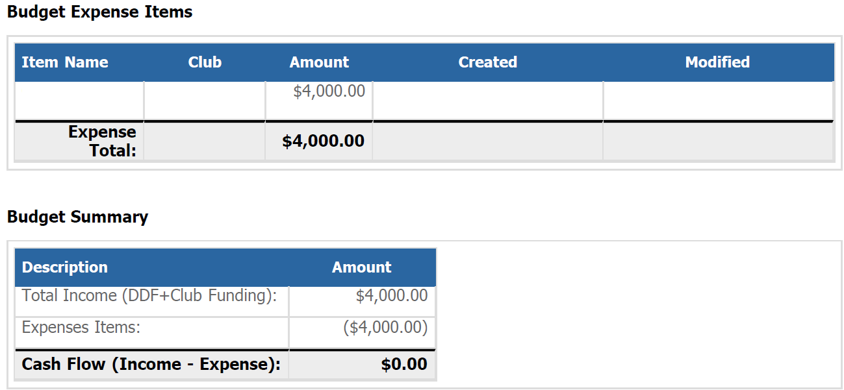
GRANT APPLICATION - BUDGET
Notes:
How the funds are being spent
Itemized list of expenses
Automatically-calculated summary of how the grant is being funded

Slide 23
DISTRICT 6200 GRANT TIMELINE
Application: May 10th (3 more weeks)
Submission by D6200 to TRF: July 1st
Receipt of funds: August 2024
Reports due: March 3, 2025
Notes:
Application: May 10th (3 more weeks)
Submission by D6200 to TRF: July 1, 2024
Receipt of funds: August, 2024
Reports due: March 3, 2025

Slide 24
Questions?
Notes:
QUESTIONS?

Slide 25
GLOBAL GRANTS
Notes:
In remaining time, cover how Global Grants differ from District Grants

Slide 26
GLOBAL GRANTS FROM THE ROTARY FOUNDATION
The other half of our District Designated Funds
What we will receive:
  2021-2022 donations from D6200: $240,802
  2024-2025 DDF: $114,381
  2024-25 Global Grants: $57,190
Global
Grants
Notes:
Funded in relation to our contributions
Funds will be deposited to District’s bank or district foundation account
Can spend up to 50% of District Designated Funds on Global Grants
$57,190
Any carryover from prior years

Slide 27
GLOBAL GRANTS
Longer-term projects
Sustainable outcomes
Larger grant awards
International partners
  Host (where the project happens)
  International
Provide World Fund match
Support the Seven Areas of Focus
Notes:
Longer-term projects
Sustainable outcomes
Larger grant awards - World Fund match available
International partnerships – MUST have an international partner club or district
Provide World Fund match for our DDF
Support one of the areas of focus – MUST fit within one
Can fund humanitarian projects, vocational training, Postgraduate studies
If you want to apply for a Global Grant, please contact me for additional help and support

Slide 28

ROTARY FOUNDATION FUNDING
Seven Areas of Focus
Notes:
Global grants must fit into one of these seven areas:
Promoting peace
Fighting disease
Providing clean water, sanitation
Saving mothers & children
Supporting education
Growing local economies
Protecting the Environment
Downloadable materials on each area
Guidelines
Policy statements
Tips

Slide 29
QUALIFYING FOR GLOBAL GRANTS
Meet the goals of an area of focus
Be sustainable
Involve Rotary clubs in two districts
Minimum total budget of $30,000
District confirms club is qualified
Notes:
Rotary clubs (as well as districts) can apply to Rotary for a global grant.
To be eligible to receive a global grant, a project or activity must
Support at least 1 area of focus and meet at least 1 of that area’s goals
Be sustainable
Involve Rotary clubs in 2 districts & 2 countries (1 in host project country, 1 in another)
Have a minimum total budget of $30,000 (including World Fund match)
The district must confirm that a club is qualified to receive a global grant.

Slide 30
GLOBAL GRANTS WON’T COVER
Continuous/excessive funding of 1 beneficiary
A foundation/trust/long-term bank account
Buying land or buildings
Constructing/renovating permanent living/ working/manufacturing structures
Duplicating Peace Center academic programs
Undergraduate scholarships
Requiring work without pay
Travel to a banned country
Notes:
Won’t Cover:
Continuously or excessively fund one beneficiary, entity, community
Establish a foundation, trust, long-term interest-bearing bank account
Buy land or buildings
Construct/renovate permanent living, working, manufacturing, structures
Duplicate Peace Center academic programs
Undergraduate scholarships
Require work without pay
Travel to a banned country

Slide 31
GLOBAL GRANTS APPLICATIONS
Open year-round
Submit w/in 12 months of starting online
Completed and approved w/in 6 months of submission
Payment requirements must be met w/in 6 months of approval
Implementation must start w/in 1 year of approval
Annual reports until project completion
Notes:
Applications open throughout the Rotary year
submitted w/in 12 months of starting online
completed and approved w/in 6 months of submission
Payment requirements must be met w/in 6 months of approval
Implementation must start w/in 12 months of approval
Annual reporting

Slide 32
DESIGNING A GLOBAL GRANT
Successful Projects:
Meet Community Needs identified by a Needs Assessment
Engage all Partners
Do Project Planning before Implementation
Funds are Budgeted and Stewarded
Follow Goal Setting
Are Sustainable
Plan for, and Measure Success
Notes:
Successful Projects
Meet community needs, do a needs assessment
Engage all Partners
Start with Project Planning
Have detailed Budgeting
Goal Setting (Measurable, Sustainable, Qualitative & Quantitative, Collect baseline data)
Sustainable
Address community need, build on its strengths, aligns with its culture
Encourage local ownership, Provide training, Buy local, Find local funding
Plan for and measure success

Slide 33
GLOBAL GRANT FINANCING GUIDELINES
International sponsor(s) provide at least 15% of total sponsor funding
Funds cannot be raised from beneficiaries or cooperating organizations in exchange for a grant
Funds can’t come from other Rotary grants
Detailed financial records & reports
Notes:
International sponsors of projects are required to provide at least 15% of the total sponsor funding.
Rotarians cannot collect funds from beneficiaries or cooperating organizations in exchange for receiving the grant.
Contributions cannot come from other Rotary grant projects.
Detailed record-keeping and financial reports (receipts)
(If time allows) Discussion questions:
How do you motivate donors to financially support TRF?

Slide 34
GLOBAL GRANT BUDGETING
Funding Sources (Use the Global Grant Calculator)
  DDF - 80% match from the World Fund
  Cash – no match, 5% deducted to offset processing & administrative costs
  Directed Gifts
$30,000 minimum
$400,000 maximum match by the World Fund
Notes:
Funding Sources (Use the Global Grant Calculator)
DDF - 80% match by World Fund
Cash – no match, 5% deducted to offset processing/administrative costs
Directed Gifts
≮ 15% must come from the International partner, outside the project country
$30,000 minimum
$400,000 maximum World Fund match (match is not required)

Slide 35
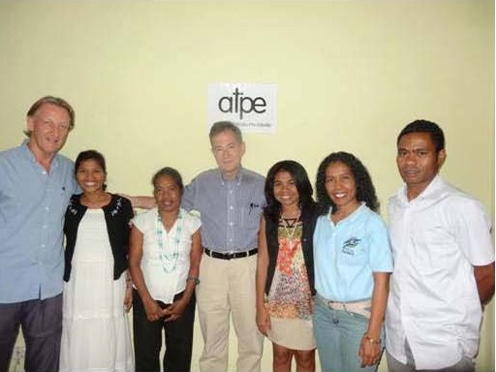
FINDING PARTNERS FOR GLOBAL GRANTS
Rotary Showcase
www.matchinggrants.org
www.rotary.org
Project fairs
LinkedIn
Facebook
Rotary Convention
Notes:
A way to do larger projects your club can’t do on their own
Can include other clubs, districts, The Rotary Foundation, or non-Rotary organizations
(If time allows) Discussion questions:
What methods have you used to find project partners?
What communication strategies worked well for maintaining communication with project partners?

Slide 36
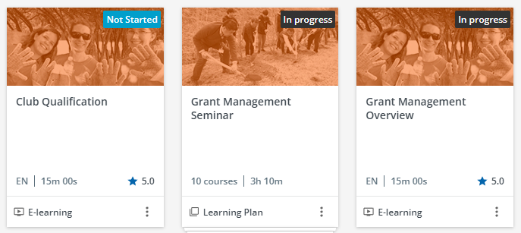
ADDITIONAL TRAINING & RESOURCES
On www.Rotary.org
  Learning Center TRF materials
  Online Grant Management Seminar
  Online Club Qualification
  Resources & Reference materials
  Online Global Grant application
Notes:
On www.Rotary.org
Learning Center TRF materials
Online Grant Management Seminar
Online Club Qualification
Resources & Reference materials
Global Grant applications

Slide 37
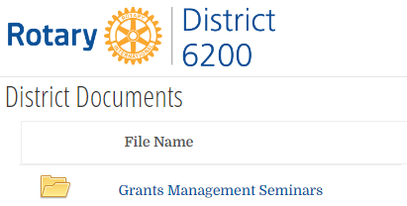
ADDITIONAL TRAINING & RESOURCES
On www.Rotary6200.org
  Online Grant Management Seminar
    Videos
    Slides
  Forms
  Resources & Reference materials
Notes:
On www.Rotary6200.org
Online Grant Management Seminar
Videos
Slides
Forms
Resources & Reference materials

Slide 38

ADDITIONAL TRAINING & RESOURCES
On www.dacdb.com
  Select District Grants
  Select Club Grants view
  Make New Club Grant Request
  Complete application
  Upload supporting documents
Notes:
On www.dacdb.com
Select Club Grants
Select Club Grants view
Make New Club Grant Request
Complete application
Upload supporting documents

Slide 39
Questions?
Notes:
QUESTIONS?

Slide 40
Greg Landry
District 6200 Foundation Chair
GregLandry@Outlook.com
(337) 255-7352

